Slide 1
Malignant Comment Classifier
Tinu Shiby

Slide 2
Problem statement
The proliferation of social media enables people to express their opinions widely online. However, at the same time, this has resulted in the emergence of conflict and hate, making online environments uninviting for users.Internet comments are bastions of hatred and vitriol. While online anonymity has provided a new outlet for aggression and hate speech, machine learning can be used to fight it. The problem we sought to solve was the tagging of internet comments that are aggressive towards other users. This means that insults to third parties such as celebrities will be tagged as unoffensive, but “u are an idiot” is clearly offensive. Our goal is to build a prototype of an online hate and abuse comment classifier which can be used to classify hate and offensive comments so that it can be controlled and restricted from spreading hatred and cyberbullying.

Slide 3
About the dataset
The data set contains the training set, which has approximately 1,59,000 samples and the test set which contains nearly 1,53,000 samples. All the data samples contain 8 fields which include ‘Id’, ‘Comments’, ‘Malignant’, ‘Highly malignant’, ‘Rude’, ‘Threat’, ‘Abuse’ and ‘Loathe’. The label can be either 0 or 1, where 0 denotes a NO while 1 denotes a YES. There are various comments which have multiple labels.

Slide 4
GOAL of the project
The aim is to train a model to classify the category to which the comment belongs to.

Slide 5
Exploratory data analysis

Slide 6
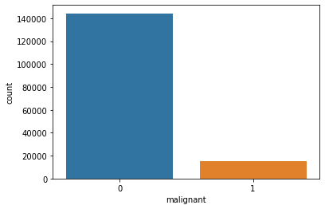
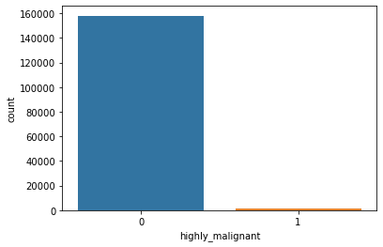
Count plot of different classes

Slide 7
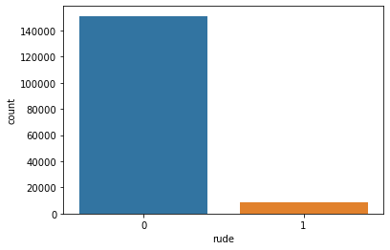
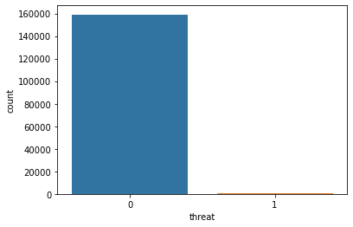
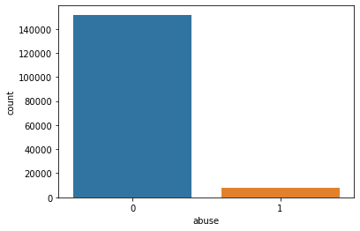


Slide 8
Data preprocessing steps
Imported and applied wordnetlemmatizer and stopwords from Natural Language Toolkit in the dataset. In which Lemmatization is the process of grouping together the different inflected forms of a word so they can be analyzed as a single item. And stopwords are English words which don't add much meaning to a word.
Created another variable called ‘Comment_length’.
Plotted the count of maximum words from each category using wordcloud.

Slide 9
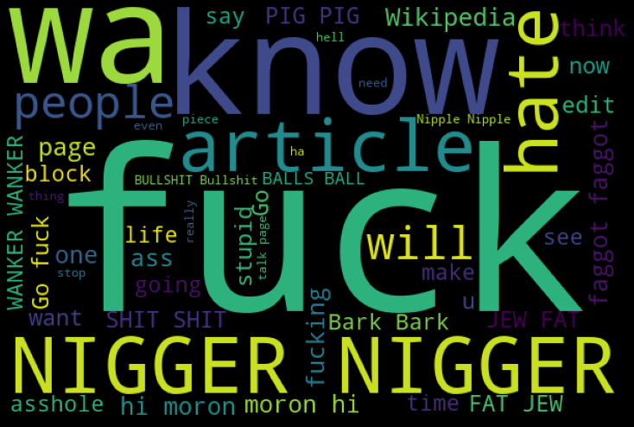

Slide 10
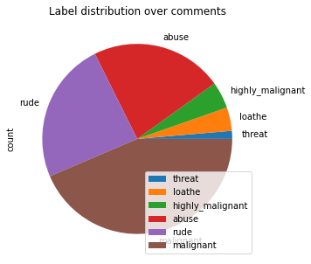
Pie graph gives the distribution of each classes

Slide 11
Converting the target variables to single variables as bad.
Input variable is comment_text, inorder to convert the text to vector applied TF-IDF.

Slide 12
Model training and evaluation
Trained the dataset on different models and below table explains the accuracy score and cross-validation score
Model | Accuracy | Cross-validation score | Difference
Logistic Regression | 95.50 | 95.64 | 0.14
Decision Tree | 94.06 | 94.12 | 0.06
Random Forest | 95.56 | 95.65 | 0.09
XGBoost | 95.23 | 95.36 | 0.13
Adaboost | 94.56 | 94.59 | 0.03
KNN | 91.67 | 91.35 | 0.32

Slide 13
Best model and hyper parameter tuning
From the above table, I have considered the Adaboost Classifier as the best model because the difference is less,, which means the possibility of overfitting is less.
After deciding the best model I have done Hyper Parameter Tuning by considering learning rate as 0.05 and n_estimators as 100.
After HPT the accuracy increased to 94.96%.

Slide 14
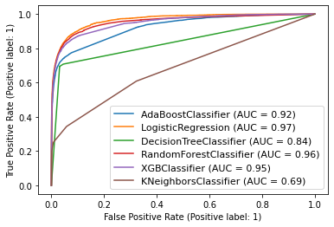
Roc-auc curve

Slide 15
Prediction for test.csv
Applied the lemmatization and TF-IDF on test dataset and predicted the class of comments.

Slide 16
conclusion
Transformation techniques like lemmatization, TF-IDF method is applied to the dataset.
Selected Adaboost Classifier as the best model.
Adaboost classifier is performing with an accuracy of 94.96%

Slide 17
THANK YOU

